Slide 1

Department of Computer Science
University Institute of Engineering
DEPARTMENT OF COMPUTER SCIENCE & ENGINEERING
Bachelor of Engineering
Subject Name: System Programming
Subject Code: CST-315
Compilers
DISCOVER . LEARN . EMPOWER

Slide 2
Types of Parser
Top-Down Parser
Bottom Up Parse
(Shift Reduced Parser)
Operator Precedence Parser
LR Parser
Backtracking
Predictive Parser
SLR
LR
LALR
CLR

Slide 3
Bottom-Up Parsing
Constructing a parse tree for an input string beginning at the leaves and going towards the root is called bottom-up parsing.
A general type of bottom-up parser is a shift-reduce parser.
SHIFT-REDUCE PARSING (SRP)
Shift-reduce parsing is a type of bottom-up parsing that attempts to construct a parse tree for an input string beginning at the leaves (the bottom) and working up towards the root (the top).

Slide 4
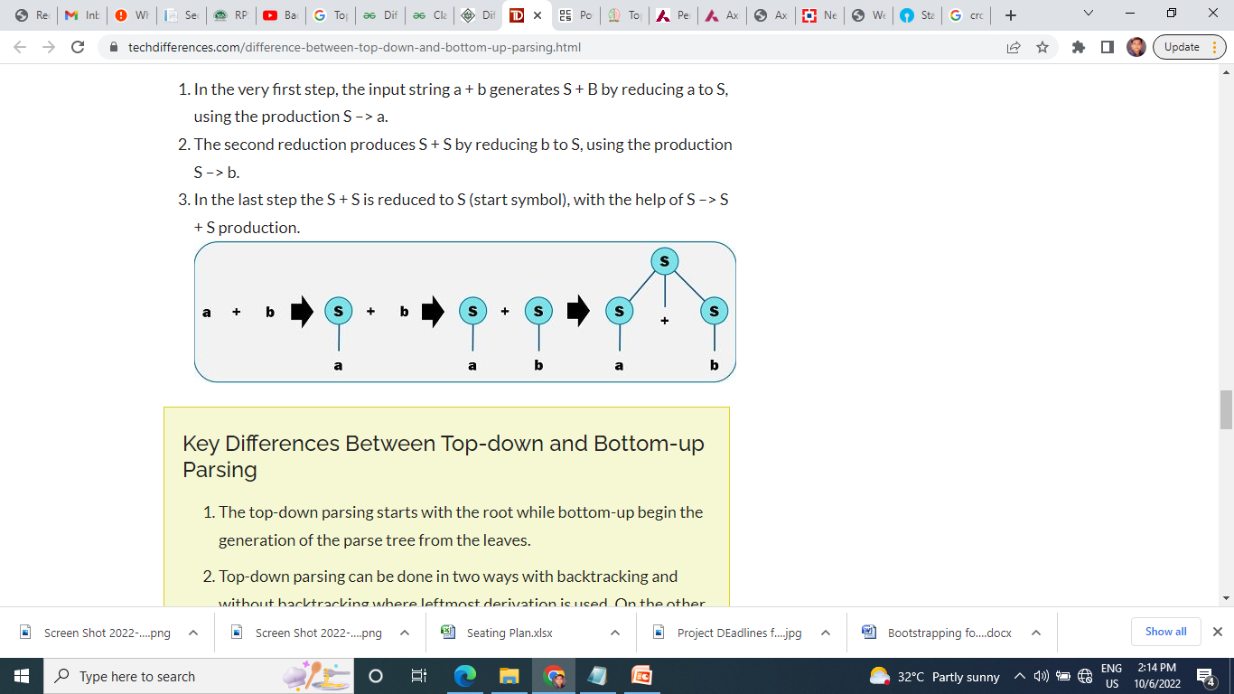
Example - Let us assume the token stream is “a+b” whose parse tree is constructed according to the below-given grammar.
G, S –> S * S | S + S | S – S | a | b
In the very first step, the input string a + b generates S + B by reducing a to S, using the production S –> a.
The second reduction produces S + S by reducing b to S, using the production S –> b.
In the last step the S + S is reduced to S (start symbol), with the help of S –> S + S production.

Slide 5
Example: Consider the grammar
Consider the grammar:
S → aABe
A → Abc | b
B → d
The sentence to be recognized is abbcde.
REDUCTION (LEFTMOST) RIGHTMOST DERIVATION
abbcde (A → b) S → aABe
aAbcde(A → Abc) → aAde
aAde (B → d) → aAbcde
aABe (S → aABe) → abbcde
S
The reductions trace out the right-most derivation in reverse.
:

Slide 6
Actions in shift-reduce parser:
• shift - The next input symbol is shifted onto the top of the stack.
• reduce - The parser replaces the handle within a stack with a non-terminal.
• accept - The parser announces successful completion of parsing.
• error - The parser discovers that a syntax error has occurred and calls an error recovery routine.
Conflicts in shift-reduce parsing:
There are two conflicts that occur in shift-reduce parsing:
1. Shift-reduce conflict: The parser cannot decide whether to shift or to reduce.
2. Reduce-reduce conflict: The parser cannot decide which of several reductions to make.

Slide 7
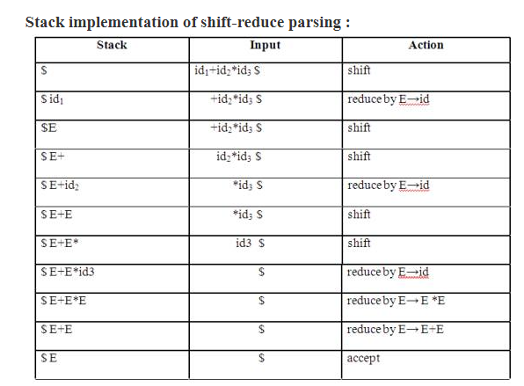
E→E+E
E→E*E
E→(E)
E→id

Slide 8
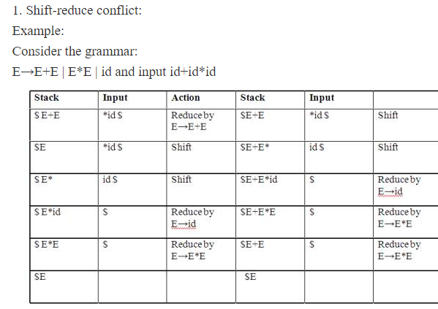

Slide 9
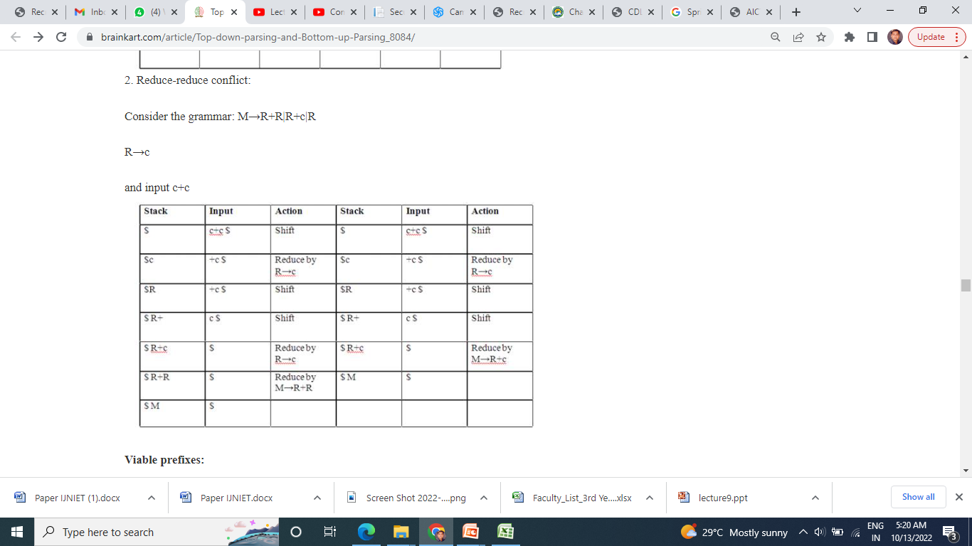

Slide 10
OPERATOR-PRECEDENCE PARSING - An efficient way of constructing shift-reduce parser is called operator-precedence parsing.
Operator precedence parser can be constructed from a grammar called Operator-grammar.
These grammars have the property that no production on right side is ɛ or has two adjacent non-terminals.
Example: Consider the grammar:
E→EAE|(E)|-E|id
A→+|-|*|/|↑
Since the right side EAE has three consecutive non-terminals, the grammar can be written as follows:
E→E+E|E-E|E*E|E/E|E↑E |-E|id

Slide 11
Operator precedence relations:
There are three disjoint precedence relations namely
<. less than
= equal to
.> greater than
The relations give the following meaning:
a<.b a yields precedence to b
a=b a has the same precedence as b
a.>b a takes precedence over b

Slide 12
Operator-precedence relations for the grammar
E→E+E|E-E|E*E|E/E|E↑E |(E)|-E|id is given in the following table assuming
1. ↑ is of highest precedence and right-associative
2. * and / are of next higher precedence and left-associative, and
3. + and - are of lowest precedence and left- Note that the blanks in the table denote error entries.

Slide 13
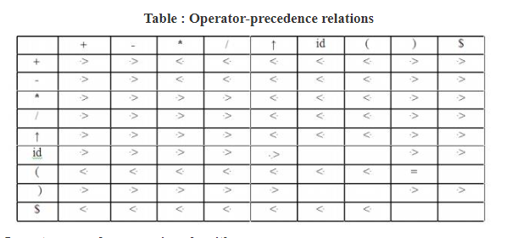

Slide 14
Stack implementation of operator precedence parsing:
It is a shift-reduce parsing containing all four actions shift, reduce, accept and error.
The initial configuration of an operator precedence parsing is
STACK : $
INPUT : w$
where w is the input string to be parsed.
Example: Consider the grammar
E → E+E | E-E | E*E | E/E | E↑E | (E) | id.
Input string is id+id*id .

Slide 15
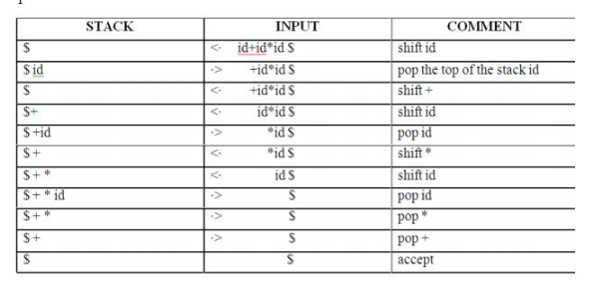
E → E+E | E-E | E*E | E/E | E↑E | (E) | id.
Input string is id+id*id .
If (stack < input ) or ( a<b) (R1)
push in stack
Else Stack > Input (a >b) pop (R2)

Slide 16
E → E+E | E-E | E*E | E/E | E↑E | (E) | id.
Input string is id+id*id . ( 5 + 4 *10 = 45)
5
4
If (stack < input ) or ( a<b)
push in stack
Else Stack > Input (a >b) pop

Slide 17
E → E+E | E-E | E*E | E/E | E↑E | (E) | id.
Input string is id+id*id . ( 5 + 4 *10 = 45)
5
4
10
*
If (stack < input ) or ( a<b)
push in stack
Else Stack > Input (a >b) pop

Slide 18
E → E+E | E-E | E*E | E/E | E↑E | (E) | id.
Input string is id+id*id . ( 5 + 4 *10 = 45)
5
4
10
*
40
If (stack < input ) or ( a<b)
push in stack
Else Stack > Input (a >b) pop

Slide 19
E → E+E | E-E | E*E | E/E | E↑E | (E) | id.
Input string is id+id*id . ( 5 + 4 *10 = 45)
5
4
10
*
40
45
If (stack < input ) or ( a<b)
push in stack
Else Stack > Input (a >b) pop

Slide 20
Advantages of operator precedence parsing:
1. It is easy to implement.
2. Once an operator precedence relation is made between all pairs of terminals of a grammar, the grammar can be ignored.
Disadvantages of operator precedence parsing:
1. It is hard to handle tokens like the minus sign (-) which has two different precedence.
2. Only a small class of grammar can be parsed using operator-precedence parser.

Slide 21
Types of Parser
Top-Down Parser
Bottom Up Parse
(Shift Reduced Parser)
Operator Precedence Parser
LR Parser
Backtracking
Predictive Parser
LR
SLR
LALR
CLR

Slide 22
LR PARSERS
An efficient bottom-up syntax analysis technique that can be used CFG is called LR(k) parsing.
The ‘L’ is for left-to-right scanning of the input,
the ‘R’ for constructing a rightmost derivation in reverse,
the ‘k’ for the number of input symbols.
When ‘k’ is omitted, it is assumed to be 1.

Slide 23
LR PARSERS
Advantages of LR parsing:
1. It recognizes virtually all programming language constructs for which CFG can be written.
2. It is an efficient non-backtracking shift-reduce parsing method.
3. A grammar that can be parsed using LR method is a proper superset of a grammar that can be parsed with predictive parser
4. It detects a syntactic error as soon as possible.
Drawbacks of LR method:
It is too much of work to construct a LR parser by hand for a programming language grammar. A specialized tool, called a LR parser generator, is needed. Example: YACC.

Slide 24
Types of LR parsing method:
SLR- Simple LR - Easiest to implement, least powerful.
2. CLR- Canonical LR - Most powerful, most expensive.
3. LALR- Look-Ahead LR - Intermediate in size and cost between the other two methods.

Slide 25

The LR parsing algorithm:
The schematic form of an LR parser is as follows:

Slide 26
References
Department of computer Science
[PDF] Systems Programming and Operating Systems by Dhamdhere - Free Download PDF (dlscrib.com)
[PDF] Principles of Compiler Design By Alfred V. Aho & J.D.Ullman Free Download – Learnengineering.in

Slide 27
THANK YOU

